Slide 1
Energetic Corporation
Construction
Tourism
Areni HEK LLC

Slide 2
Energetic corporation structure
The Energetic corporation is licensed for hydro power plant building and exploitation.
The Energetic Corporation has its own departments for development and technical design of hydro power plants.
Employees of the Energetic Corporation development and technical design of hydro power plants departments are highly skilled specialists who are licensed for the technical designing of hydro power plants accordingly.
The Energetic Corporation has it’s own technical fleet for hydro power plants construction.
The Energetic Corporation has advanced structure presented by shareholders, directors, accountants, lawyers, technical consultants.
Each of below mentioned implemented projects has it’s local management presented by Executive Directors, deputy directors, accountants, senior operators, operators.

Slide 3
Executive Summary
The Energetic Corporation has it’s branches which are presented by Hydro Corporation CJSC, Mina-Maya LLC, Areni HEK CJSC.
“Hydro Corporation” CJSC was established in October, 2004 for the implementation of Argichi Hydro Power Plants.
“Mina-Maya” LLC was established in 2008 for the implementation of “Eghegnadzor” SHPP project in Vayots Dzor marz, Armenia.
In 2011 “Areni HEK “ CJSC was established for the purpose of implementation “Areni” Small hydro power plant, situated also in Vayots Dzor marz.

Slide 4
Established in October 4, 2004
Charter Capital of the Company –
AMD 1,100,000,000 (USD 3,000,000).
1,100 outstanding registered shares,
with AMD 1,000,000 (USD 2.700) face value.

Slide 5
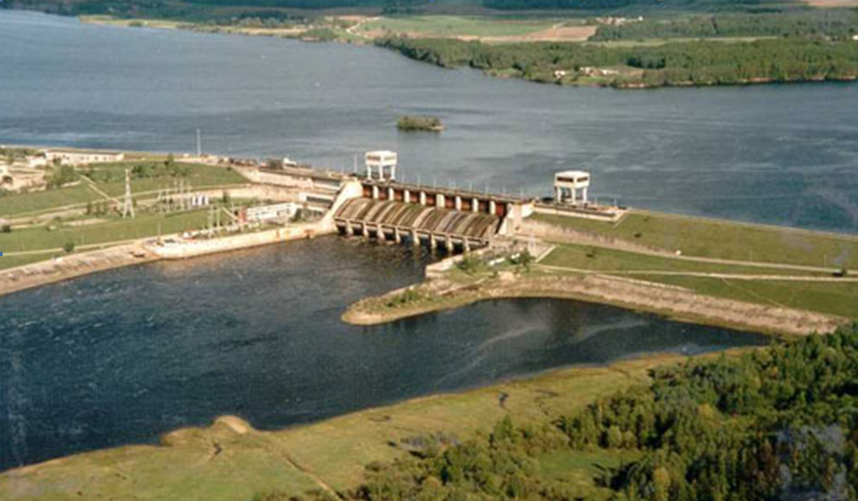
Project of “ARGICHI” small hydro power plant
The main purpose of the project activity is generation of clean hydroelectric energy and contribution to climate change mitigation efforts.
Project location – Armenia, Gegharkounik Marz, Madina village
Generation capacity – 8.56 Mw
Total investment required – 11,43 mln USD
Annual electricity generation – 30.5 mln kWh
Green tariff – 23,461AMD / 0.063 USD/kWh (with VAT)
Guaranteed purchase – 15 years starting from the date of operation
The license for construction of SHPP was issued by PSRC in 2004
The project was registered by CDM EB in 2007. Ref No 1459, Annual CERs – 13 000 tones of CO2e
The electricity generated by Argichi SHPP will be sold to Electric Networks of Armenia

Slide 6
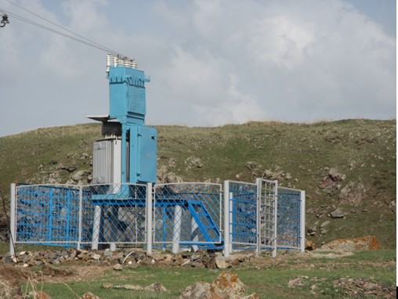
EXECUTIVE SUMMARY
The “Argichi” SHPP has been validated and registered by CDM EB within the framework of Kyoto Protocol (http://cdm.unfccc.int/Projects/projsearch.html).
Environment Impact Assessment (EIA) has been conducted by State Environmental Agency of Armenia and World Bank.
The following documents and permissions are prepared for the construction and exploitation of Argichi SHPP:
Certificate of owning the land with 9,5 hectare
Techno-economical study
Water usage permission
Certificate of water inventory
Working plan, worked out by “Armhydroproject”
License of construction
Environmental Impact assessment, worked out by EBRD
Technical expertise
Ecological expertise
Permission of construction
The head unit is concrete platinum with 7m pressure which makes a daily regulator pool with 1.6ha surface.
Pressure derivative conduit starts from the head unit.
The total length of derivation is 9530; the diameter of the pipe is 1420mm
“Argichi” HPS is projected with the following primary factors:
Rated pressure: 253.1m
Calculated consumption: 4 m³/s
Energetic flow: 50.1 mln m³
Installed capacity: 8.56Mw
Average multi-year output of electric power: 30.5 mln kWh

Slide 7
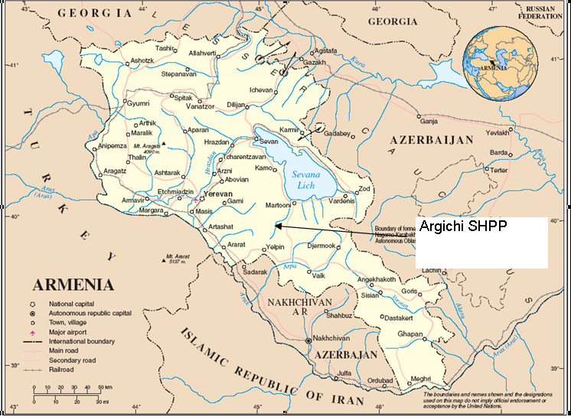
PLANT DESCRIPTION
“Argichi” SHPS is being built on Argichi river in Gegharkounik marz of RA using river fall between guide marks 2247 and 1960. 70% of planned works are already done .
GPS coordinates:
Latitude: 40° 7’ 29’’
Longitude: 45° 15’ 29’’
The river is typical mountain river, systematically studied since 1927, one of the largest inflows of Lake Sevan.
The annual distribution of the flow is characterized with strictly expressed strong water-voluminous.
In the sections of head unit on the bank of the river the water collection surface is 314km².
In Argichi pool there is an irrigation network. Taking account the future irrigation of the areas
the total irrigation demand will be 3.4 million m³/y.
In order not to dishwater the river, according to the decision No.592 of Government of RA,
on May 22, 2003, as a norm of nature protection 0.4 m³/s is specified.
Considering the requirements of fishing industry, the value of nature protection flow is accepted as 1.0 m³/s.
In the section line of “Argichi” HPS head constructions water regime is the following:
Natural average multi-year flow 140.2 mln. m³
Nature protection flow 31.56 mln. m³
Demand for irrigation 3.4 mln. m³
Flow possible for power uses 107.5 mln. m³
“Argichi” HPS is of derivative type.
The head unit of HPS is on 2242 m of river mark, 3 km distance up to Madina village.

Slide 8
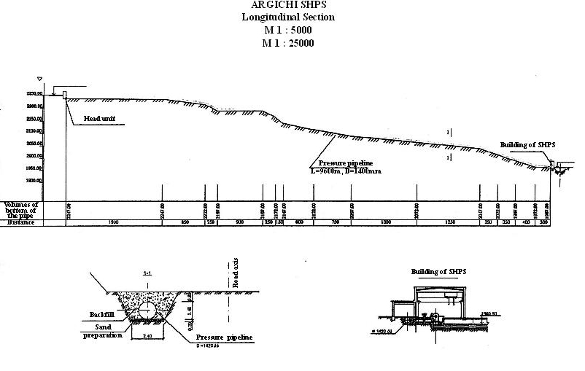
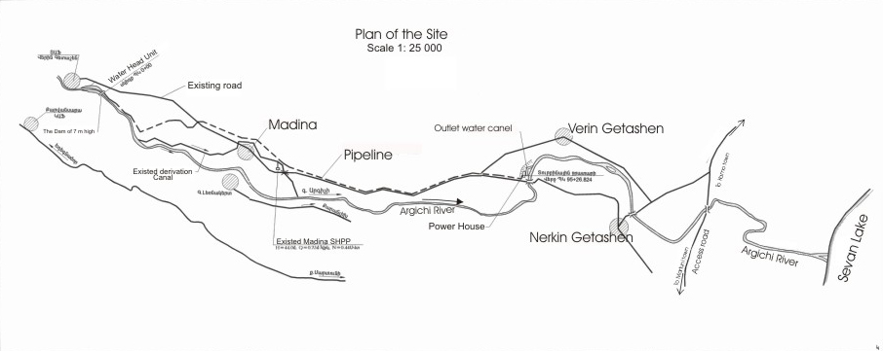
Longitudinal Section of derivation
Scheme of Argichi SHPP location “in principle”

Slide 9
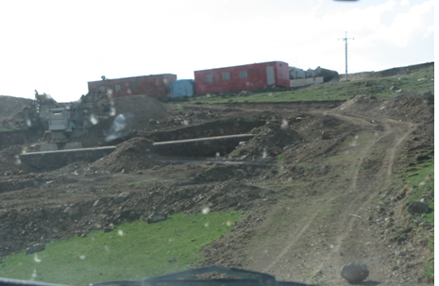
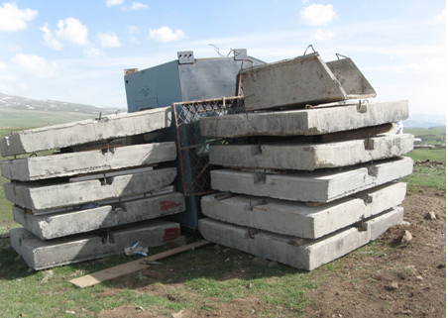
PROJECT CONTRIBUTION TO SUSTAINABLE DEVELOPMENT
Social : The project activity will
Create job opportunities in the area with very high unemployment level for skilled and unskilled labor during the construction and operation of the plant.
Contribute to development of experience and intellectual capacity among the local construction workers that will go through a set of trainings, organized by the Project Host during the project implementation, which will help them to become a skilled work force in future as well.
A new irrigation channel will be constructed for Madina village. Implementation of the project will also
Environmental: According to the Environmental Impact Assessment conducted for this project in accordance with World Bank environmental Standards, the construction of the Argichi SHPP will not affect the quality of the river water, as well as the well being of the local population.
Policy effect : The project activity complies with the Energy Strategy of Republic of Armenia which promotes the development of new renewable energy technologies and capacities. In addition, implementation of the project will also contribute to the sustainable development of Armenia through reducing the dependence on imported energy carriers, such as natural gas, thereby reducing the outflow of capital from Armenia to other countries.
Economic : During the operation of the Argichi SHPP the expected tax revenue (including local – property taxes, and state – VAT and income taxes) will account to around USD 400,000 per annum.

Slide 10
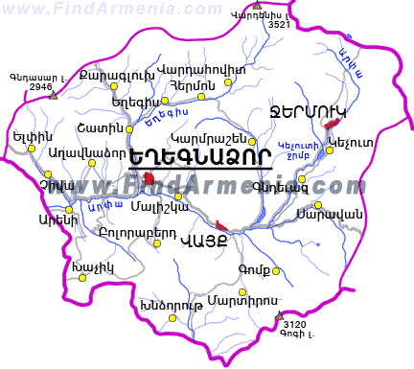
Mina-Maya LLC was established in 2008.
The main project is “Eghegnadzor” SHPP project, a run-of-river hydro power plant sited in Yeghegis river,Vayots Dzor marz, Armenia.
The project has two hydro-electric power plants on the same river with marks of “Eghegnadzor” and “Eghegnadzor-1” accordingly.

Slide 11
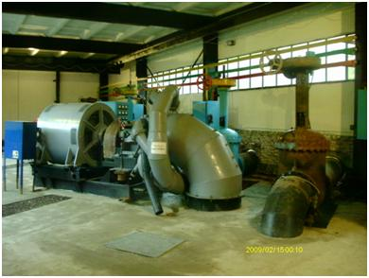
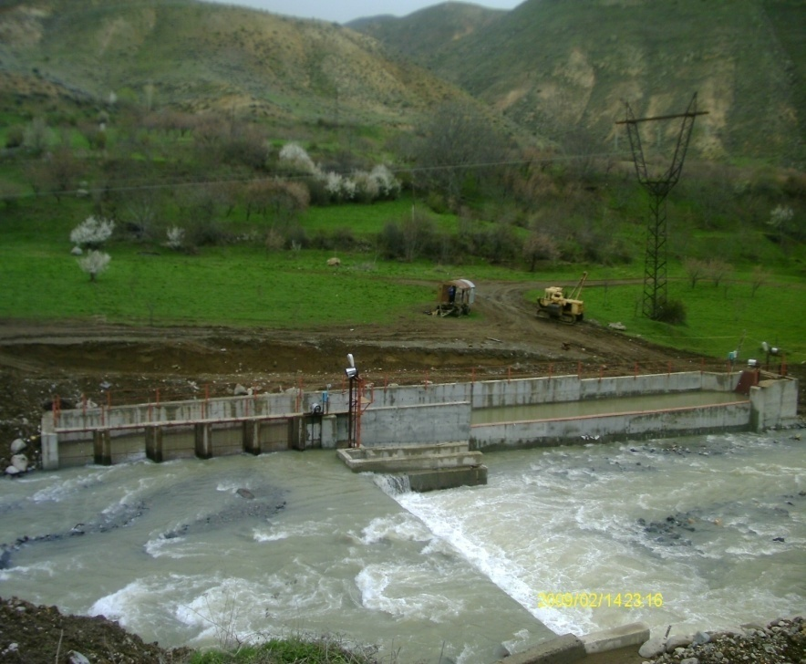
Disposition and power ability
Mina-Maya Ltd has received the license of Contruction and built Eghegnadzor SHPP with 3 Mwt installed capacity.
In 2010 Mina-Maya acquired “Eghegnadzor-1 ”Hydro Power Project, which is a run-of-river hydro power plant sited in Yeghegis river.
The project has it’s capacity installed power with 2.5Mwt.

Slide 12
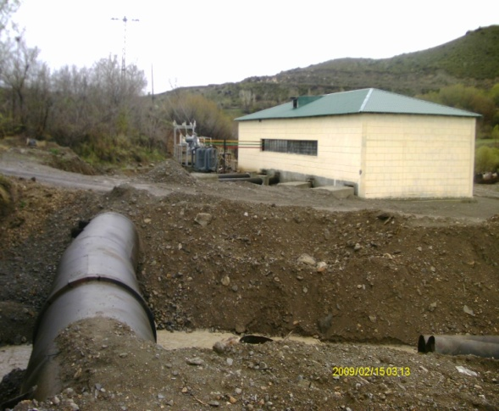
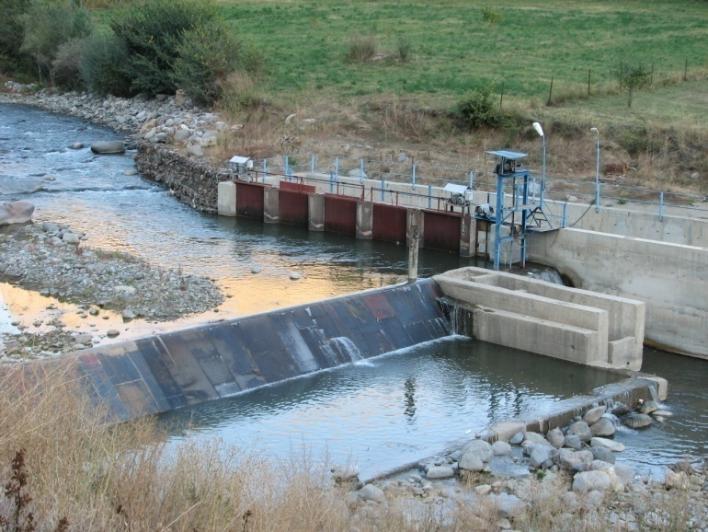
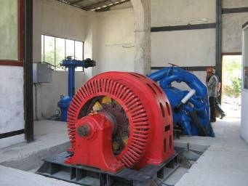
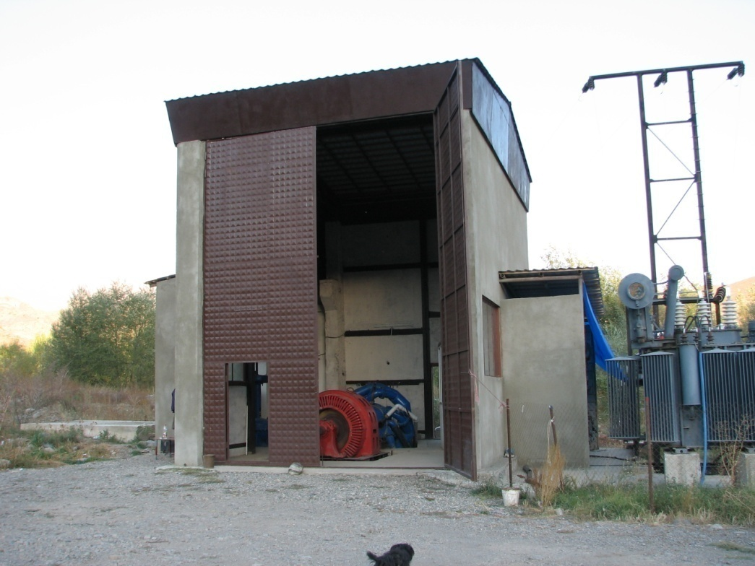
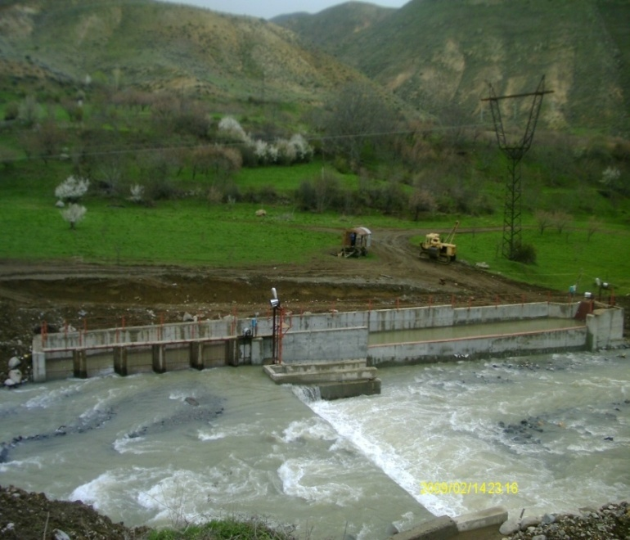

Slide 13
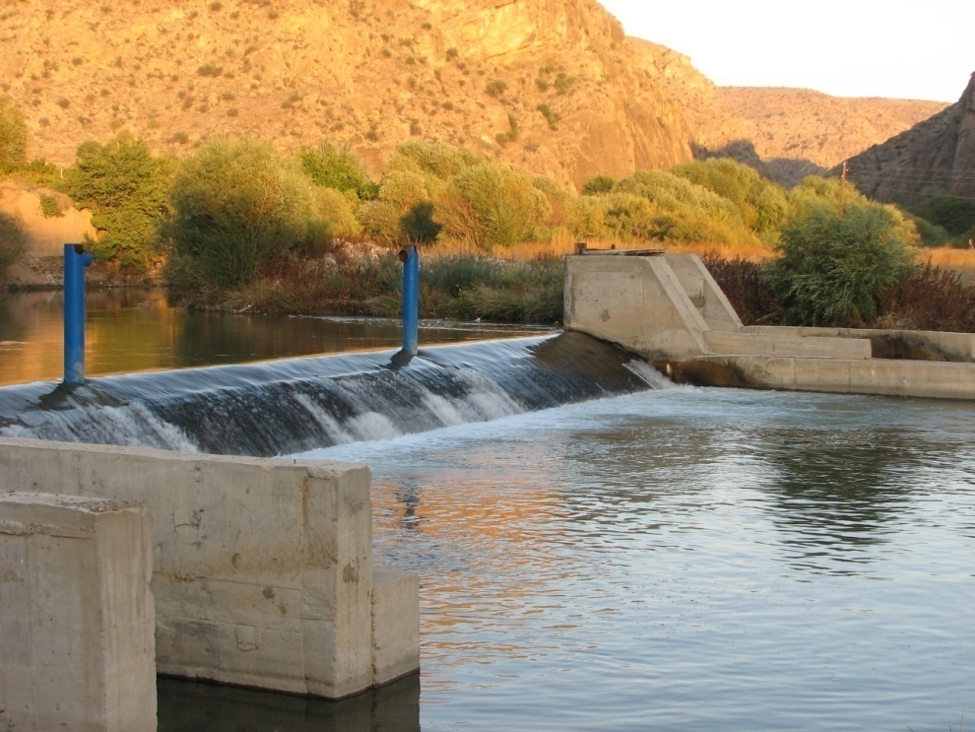
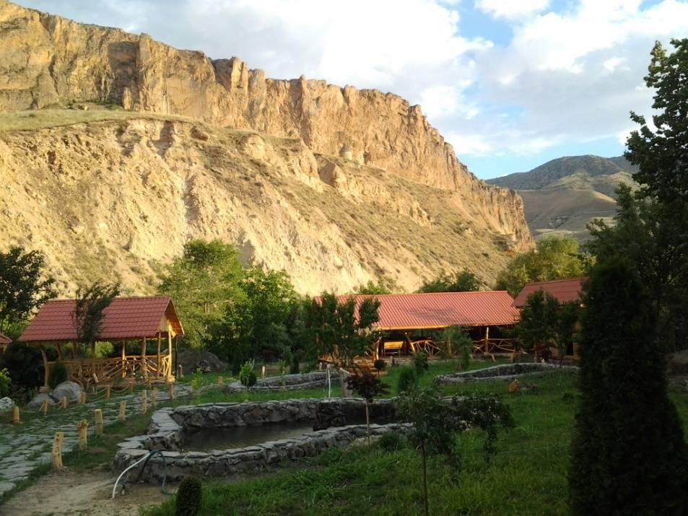
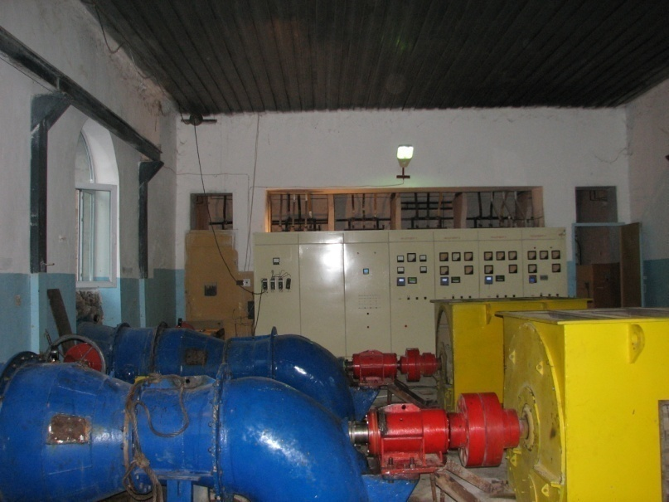
Areni HEK LLC
In 2011 “Areni HEK LLC” was established for the purpose of implementation “Areni” Small hydro power plant, a run-of-river hydro power plant sited in Arpa river, Vayots Dzor marz.
Areni SHPP is exploitating with 2 Mwt capacity. It is situated under the church below sheer cliff in quite inaccessible area.

Slide 14
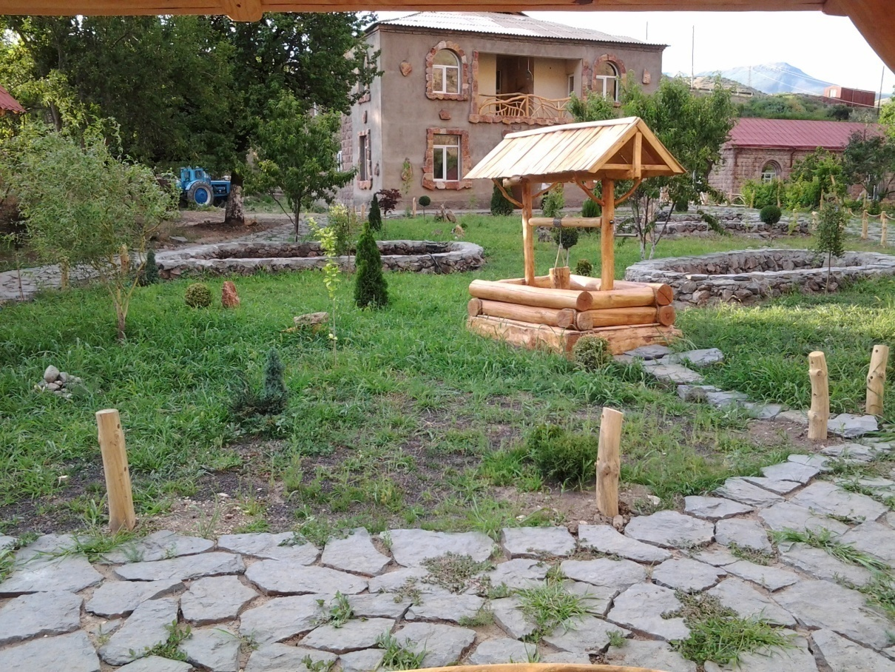
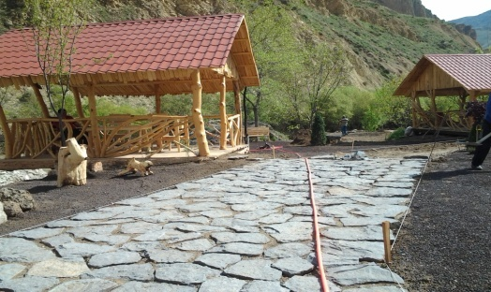
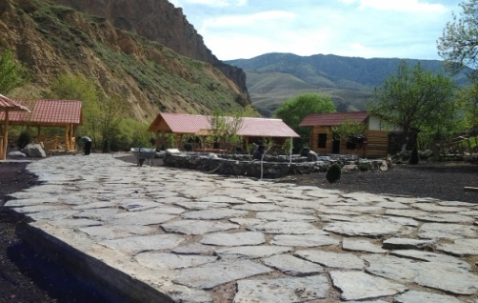
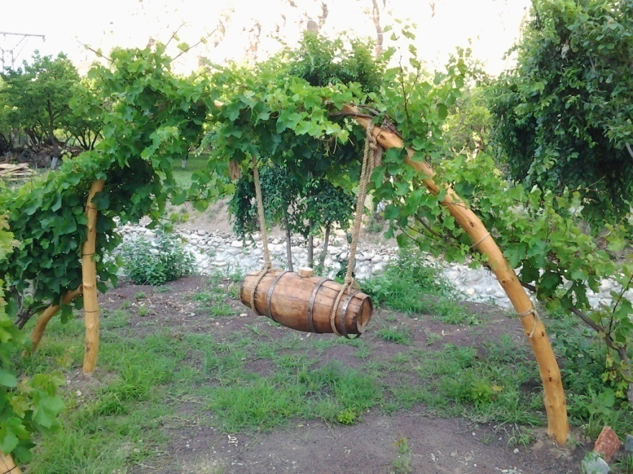
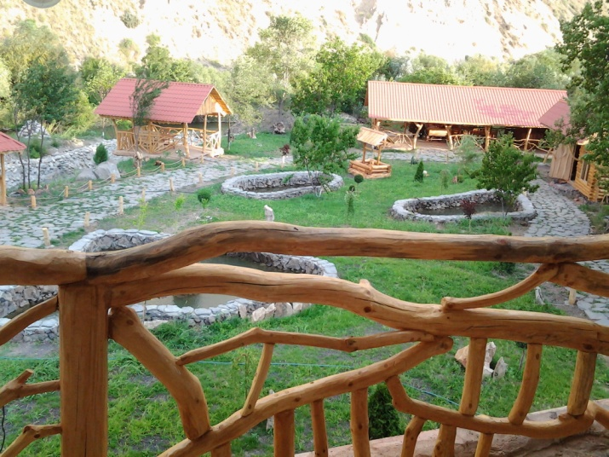
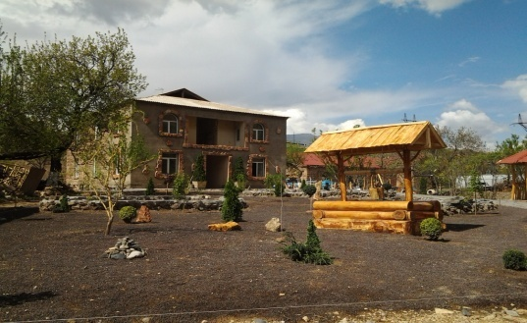
TOURISM
Areni HEK LLC
Areni is developing not only the renewable energy sphere but tourism and nature protection.
SHPP is surrounded with nice sightseeing and Tour zone build by Our Company.

Slide 15
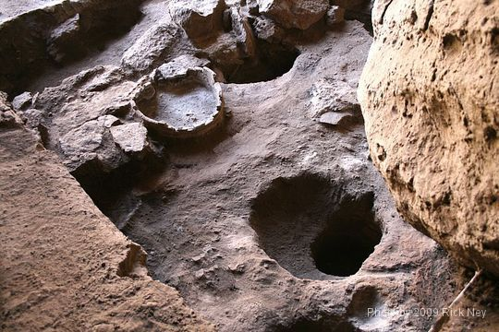
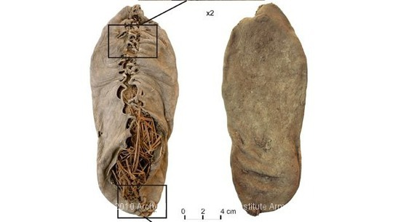
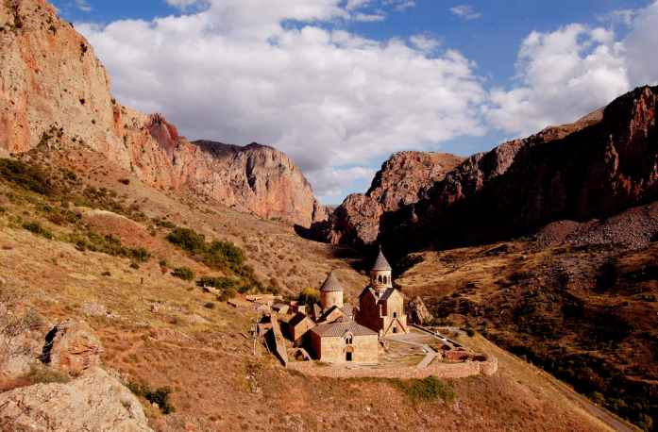
TOURISM
Areni HEK LLC
Areni is a village in the Vayots Dzor Marz of Armenia. It is best known for its wine production. The church of S. Astvatsatsin is a single-nave two-aisled domed Armenian church completed in the year 1321, and is located atop a plateau overlooking the Arpa River and Areni. It was designed by the architect and sculptor Momik Vardpet who is best known for his high-relief carvings at the monastery of Noravank (located approximately 6 kilometers southeast from Areni). Nearby are also the 13th century ruins of lord Tarsaitch Orbelian of Syunik's palace, moved from Yeghegis to Areni during that time. Ruins of a 13th century bridge built by Bishop Sarkis in 1265-1287 are to the northeast of the church one kilometer. At the same location are the remains of an older bridge.
First Direct Evidence of Chalcolithic Footwear from the Near Eastern Highlands
Abstract In 2008, a well preserved and complete shoe was recovered at the base of a Chalcolithic pit in the cave of Areni-1, Armenia. Here, we discuss the chronology of this find, its archaeological context and its relevance to the study of the evolution of footwear. Two leather samples and one grass sample from the shoe were dated at the Oxford Radiocarbon Accelerator Unit (ORAU). A third leather sample was dated at the University of California-Irvine Accelerator Mass Spectrometry Facility.
Mentioned historical place is located near Areni tourist zone which is presented above, it’s one of the success keys for development of the tourist zone of Areni as long as it’s a place for tourists in order to visit it whole year.
The road is one of the most beautiful roads in Armenia. It slices through high mountains and takes you to the hidden monastery. Notice the caverns on the left side of the road, they are actually very deep and sometimes serve as hiding place for the rare leopard and various species of bats. Also, one of the caves in the beginning of the road has Bronze Age child burials.
The entire region from Areni to Eghegnadzor is known for the deep caverns, most of them are not fully explored.

Slide 16
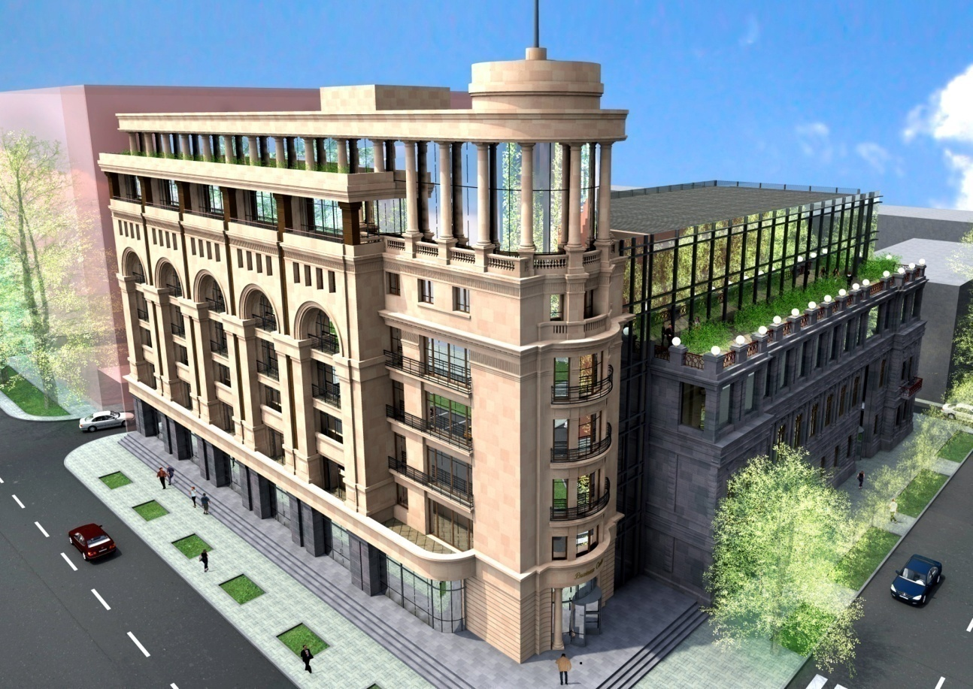
Construction
Royal Classic House
A unique multifunctional residential complex located in the hearth of Yerevan. The building is next to the Republic square, right on the place, where Old traditions end and New city is starting.
The main aim is to provide Royal Lifestyle with Classic Traditions.

Slide 17
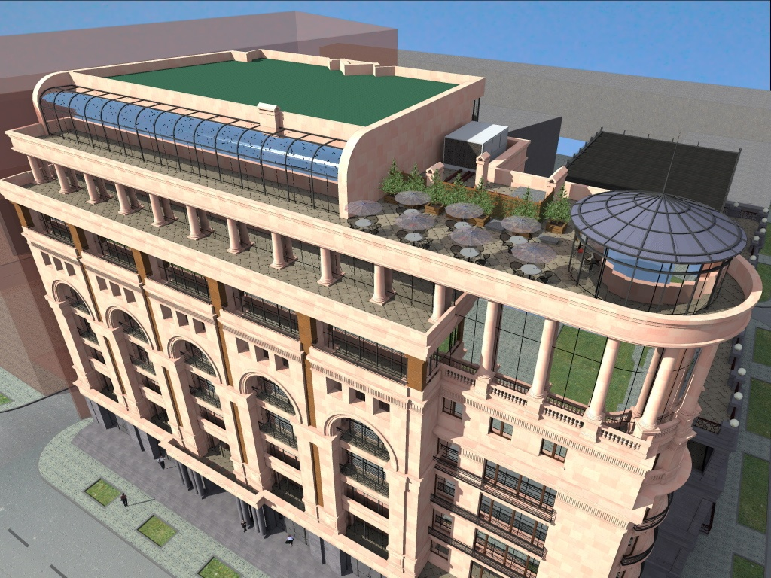
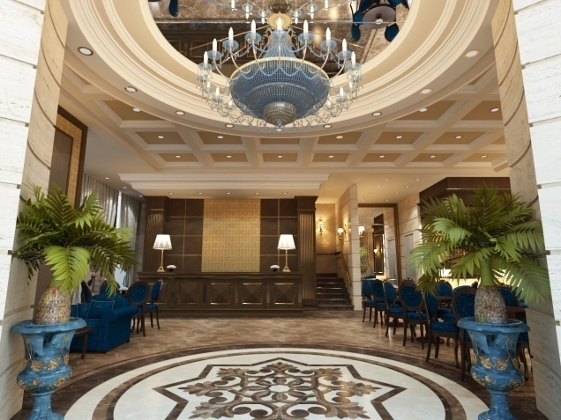
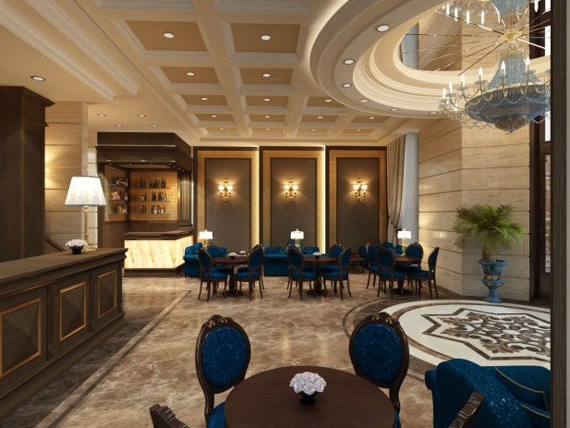
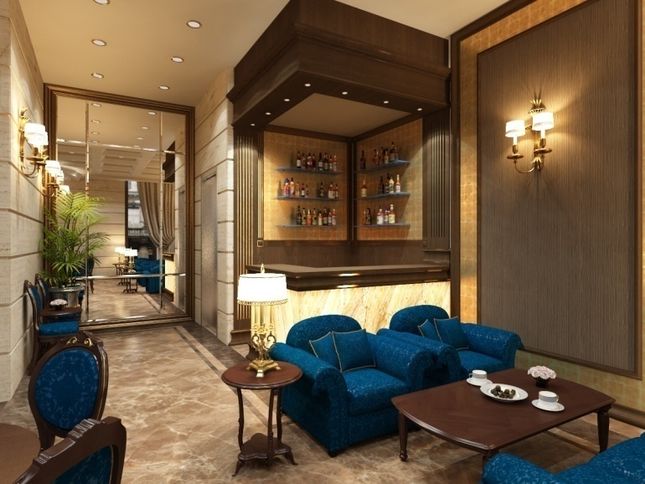
Construction

Slide 18
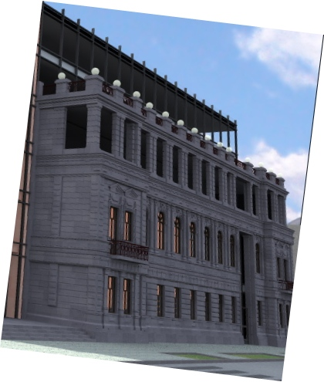
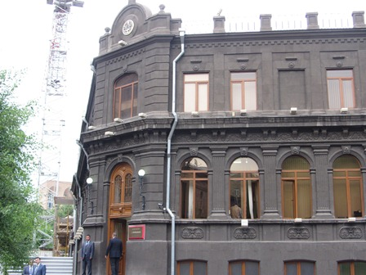
Construction
The ruling Republican Party’s central residence was also built by our Company.
Our company is entrusted with the construction of the next part of this building which is already planned.

Slide 19
Thank you for attention We hope for the prospective and productive cooperation

